Slide 1

VEHICLE TRACKING APP
V.T. A
GROUP MEMBERS | REGISTER NUMBERS
Kevin S Paul | RA1911003010599
Rakshika Singh Rana | RA1911003010591
Chappa Nitin Raghuram | RA1911003010598

Slide 2
A vehicle tracking system combines the
01
use of automatic vehicle location in individual vehicles with software that collects
these fleet data for a comprehensive picture of vehicle parking. Vehicle
information can be viewed on electronic maps via specialized software.

Slide 3
PROBLEM STATEMENTS-
02
Provides a remote.
IT works as a remote to locate your vehicle easily .while in this developing world
Locating one car among thousands more of the same branded cars in a parking line is
a tedious and time taking job, consuming a lot of time
Due to increase in the number of vehicles in the central city creates congestion, wastage of space, time and traffic problems, carnapping, car vandalism.

Slide 4

REQUIREMENTS
03
Functional Requirements
Non-Functional Requirements Infrastructure Requirements
Requirement definition in Agile

Slide 5
FUNCTIONAL REQUIREMENTS:
REQUIREMENTS | REQUIREMENTS SPECIFICATION | DEPARTMENT | NUMBER OF BUSINESS USER | STATUS
E1FR1 | USER WILL PROVIDE A FORM FOR REGISTRATION | FRONT-END | FRONT-END DEVELOPER | ACTIVE
E1FR2 | ALL THE STAKEHOLDERS GIVE THEIR FEEDBACKS | BACK-END | BACK-END DEVELOPER | ACTIVE
E1FR3 | UPDATING THE APP AND PROVIDING WITH REQUIREMENTS | FRONT-END | FRONT-END DEVELOPER | ACTIVE
E1FR4 | TRANSACTION CORRECTIONS, ADJUTMENTS AND CANCELLATIONS | FINANCE | FINANCE ANALYST | ACTIVE

Slide 6

NON-FUNCTIONAL REQUIREMENTS:
REQUIREMENTS | CATEGORY OF NIFR | REQUIREMENTS SPECIFIED | DEPARTMENT | NAME OF BUSINESS USER | STATUS
NFR1 | PERFRMANCE | ALL PAGES SHOULD LOGIN WITHIN 3 SEC | FRONT-END | FRONT-END DEVELOPER | ACTIVE
NFR2 | PERFORMANCE | SEACH SHOULD BRING RESUTS IN 3 SEC | FRONT-END | FRONT-END DEVELOPER | ACTIVE
NFR3 | AVAILABILITY | APPLICATION MUST BE AVAILABLE FOR 24*7 | BACK-HAND | BACK-END DEVELOPER | ACTIVE
NFR4 | USABILITY | EASY TO USE AND HANDLE | FRONT-END | FRONT-END DEVELOPER | ACTIVE
NFR5 | RELIABILITY | SITE SHOULD NOT GO DOWN | SERVER MAINTAINENCE | SOFTWARE ENGG. | ACTIVE
NFR6 | RAPIDITY | INTEGRATE NEW PAYMENT INTEGATOR | FINANCE | FINANCE ANALYST/EXPERT | ACTIVE
NFR7 | SECURITY | MAINTAINING SECURITY AND PRIVACY POLICY | TECHNICAL TEAM | SOFTWARE ENGG. | ACTIVE
NFR8 | MAINTAINABILITY | USER DETAILS DATABASE | BACK-END | BACK-END DEVELOPER | ACTIVE

Slide 7
INFRASTRUCTURAL REQUIREMENTS:
REQUIREMENTS | REQUIREMENTS SPECIFICATION | DEPARTMENT | NAME OF BUSSINESS USER/TEAM MEMBER | STATUS
IR1 | DEVELOPMENT MACHINE WITH 12GB RAM AND 4 GB CORES | PROJECT MANAGEMENT | KEVIN RAKSHIKA NITIN | ACTIVE
IR2 | SERVER LOCATION | TECHNICAL | KEVIN | ACTIVE
IR3 | OFFICE | TECHNICAL | RAKSHIKA AND NITIN | ACTIVE

Slide 8
04
ARCHITECTURE DIAGRAMS
USE CASE DIAGRAM
DFD DIAFRAM
CLASS DIAGRAM
COLLABORATION DIAGRAM
STATE DIAGRAM
DELOYMENT DIAGRAM

Slide 9

SOFTWARE USED:
STAR UML RATIONAL ROSE CREATLY

Slide 10


USE CASE DIAGRAM
4.1

Slide 11
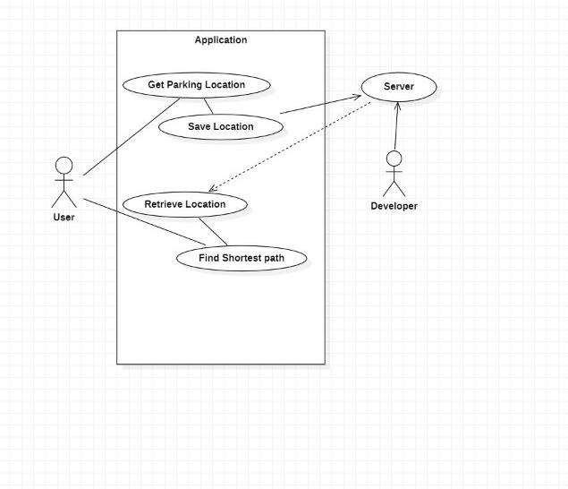

Slide 12


DATA FLOW DIAGRAM
4.2

Slide 13
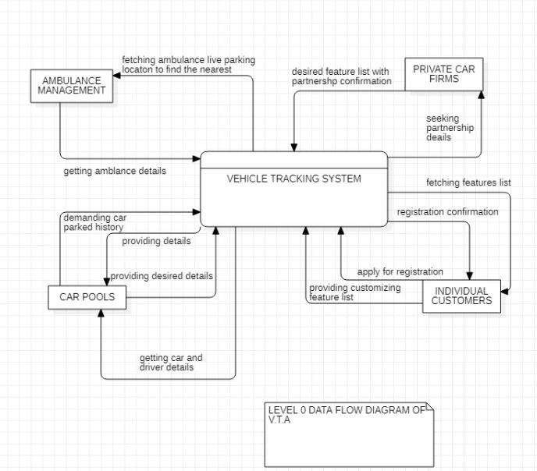

Slide 14
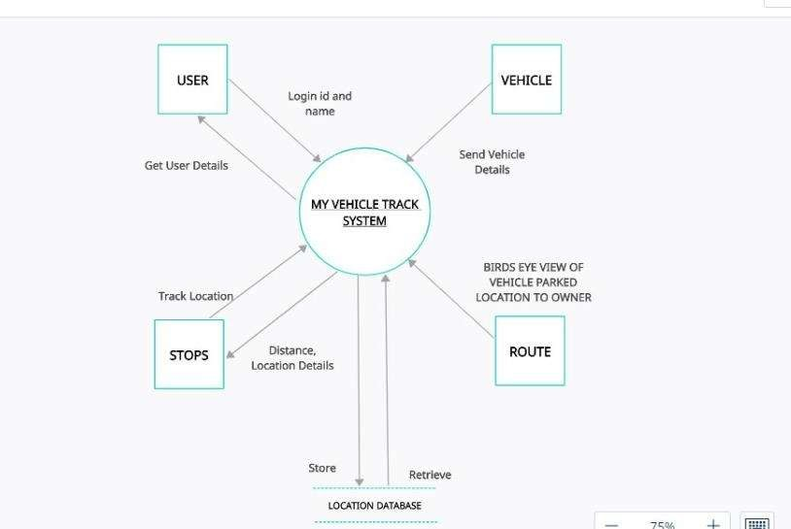

Slide 15


CLASS DIAGRAM
4.3

Slide 16
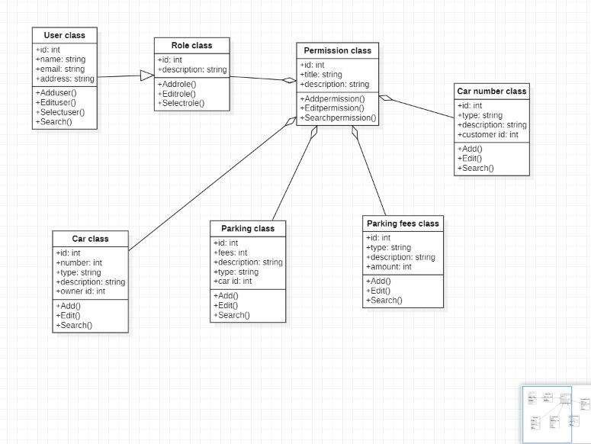

Slide 17
COLLABORATION DIAGRAM
4.4

Slide 18
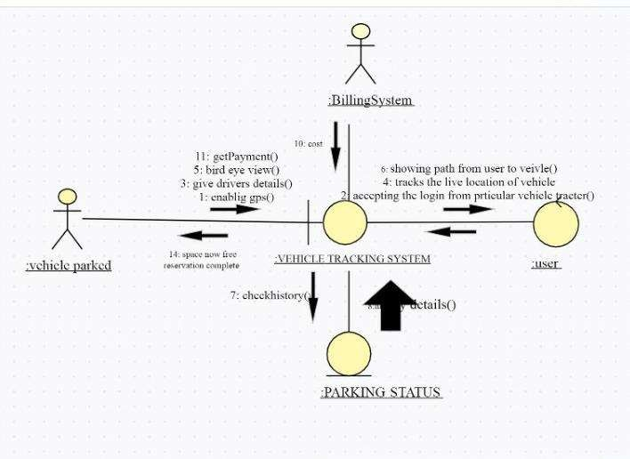

Slide 19


STATE DIAGRAM
4.5

Slide 20
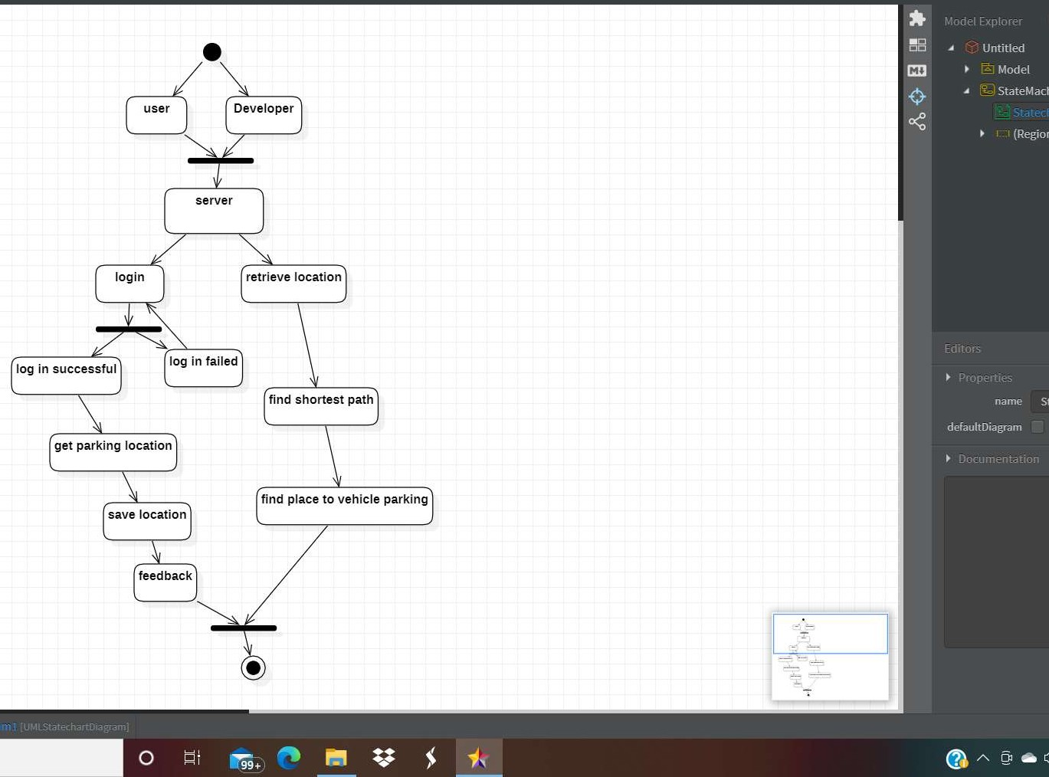

Slide 21




DEPLOYMENT DIAGRAM
4.6

Slide 22
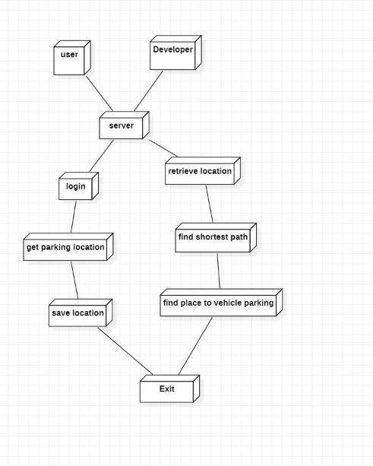

Slide 23

GLIMPSE OF APP
05

Slide 24
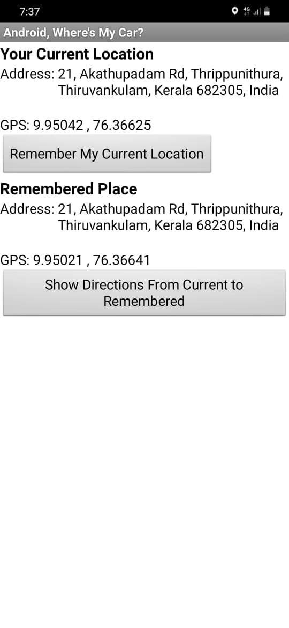


Slide 25
C ODED M ODULE NUM BER 1
06

Slide 26
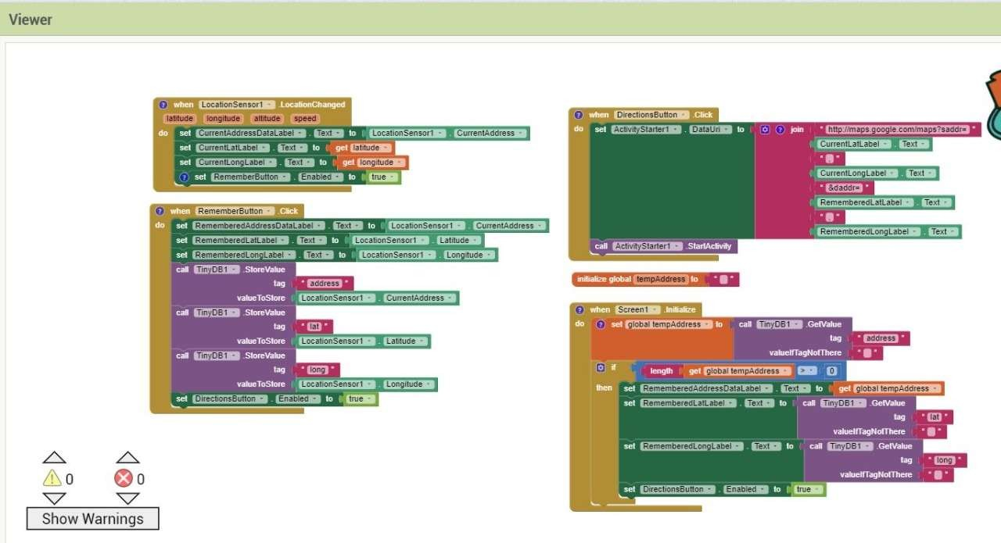

Slide 27
C ODED M ODULE NUM BER 2
07

Slide 28
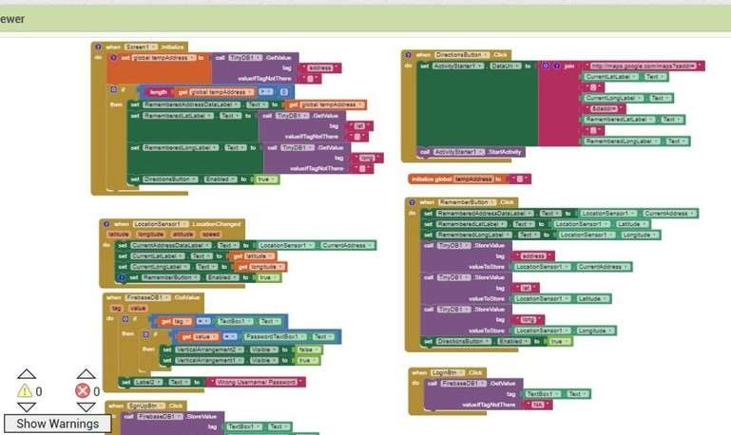

Slide 29
C ODED M ODULE NUM BER 3
08

Slide 31
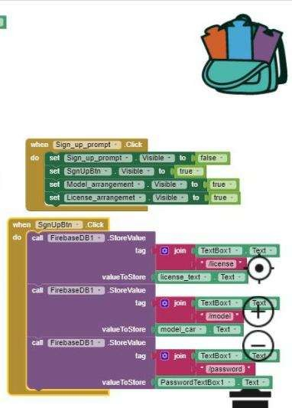

Slide 32










How our APP is looking
09

Slide 33
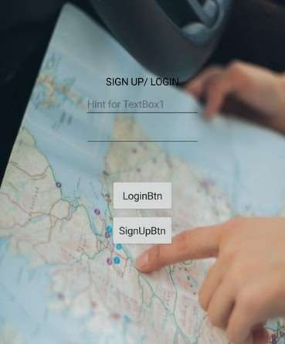
PA GE NO.1
L O G I N P A G E

Slide 34
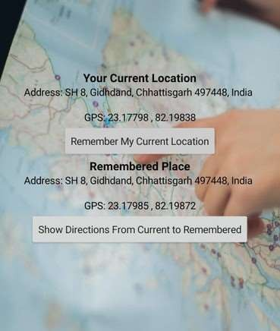
PA GE NO.2
C L I C K O N R E M E M B E R M Y
C U R R E N T L O C A T I O N

Slide 35
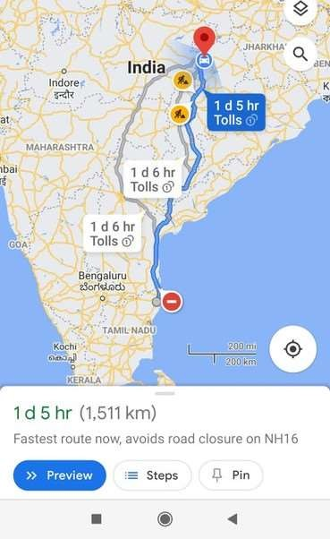
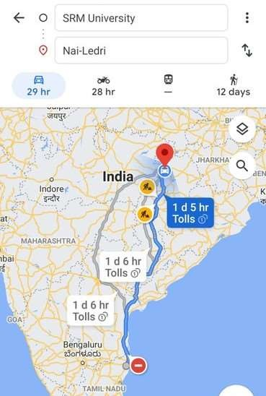
PA GE NO.3
B I R D EYE V I E W

Slide 36
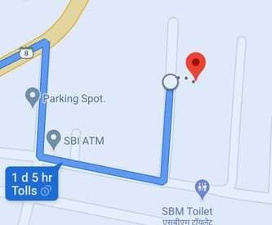
PA GE NO.4
C L O S E S T V I E W

Slide 37

Test plan template will be incorporated
10

Slide 38
01
A P P
I N STA LLA T I O N
One one click the app mut get inatalled with the ease of doing it.
02
TEST RESULT
suc c essful
03
04
D ATA U T I L I S AT I O N
The amount of data required for downloading should not exceed the limit specified i.e from
TEST RESULT
suc c essful

Slide 39
01
ON THE C L I C K OF S I G N U P BU TTON
At first users have to fill all fields with proper data ,if u want to sign in then click on the “sign in” button two more fields will appear fill then as well .
02
TEST RESULT
suc c essful
ON THE C L I C K OF LO GI N BUTTON
If u already have account just fill two credentials and the app will redirect your page to your existing account
03
04
TEST RESULT
suc c essful

Slide 40
01
02
T E ST RESULT
suc c essful
ON THE C L I C K OF “ R EMBER M Y CU R R EN T L O C AT I O N ”
This will simply display your current location just below the button bar.
ON THE C L I C K O F “ S H O W
D I R E C T I O N S F R O M C UR R E N T
03
04
TO R E M E M B E R ” B U TTO N
T E ST RESULT
suc c essful
this will redirect you to map view
and one can start their journey now

Slide 41
01
ON THE C L I C K OF V I E W
02
One has the vicinity to select “route options”, “add stoppage”, ”search along route”, “add route to home screen” this feature can specifically be used for location where we visit quie often.
Also “Map type “ and Map details can be retrieved.
T E ST RESULT
suc c essful
03
D ATA S TO R A G E
On the click of Login page the app should retrieve data successfully from firebase to display
04
T E ST RESULT
suc c essful

Slide 42
Types of Testing , Methodology , Tools
CATEGORY | METHODOLOGY | TOOLS REQUIRED
FUNCTIONAL REQUIREMENTS | MANUAL | EXCEL TEMPLATE
NON-FUNCTIONAL REQUIREMENTS | MANUAL | EXCEL TEMPLATE
11

Slide 43


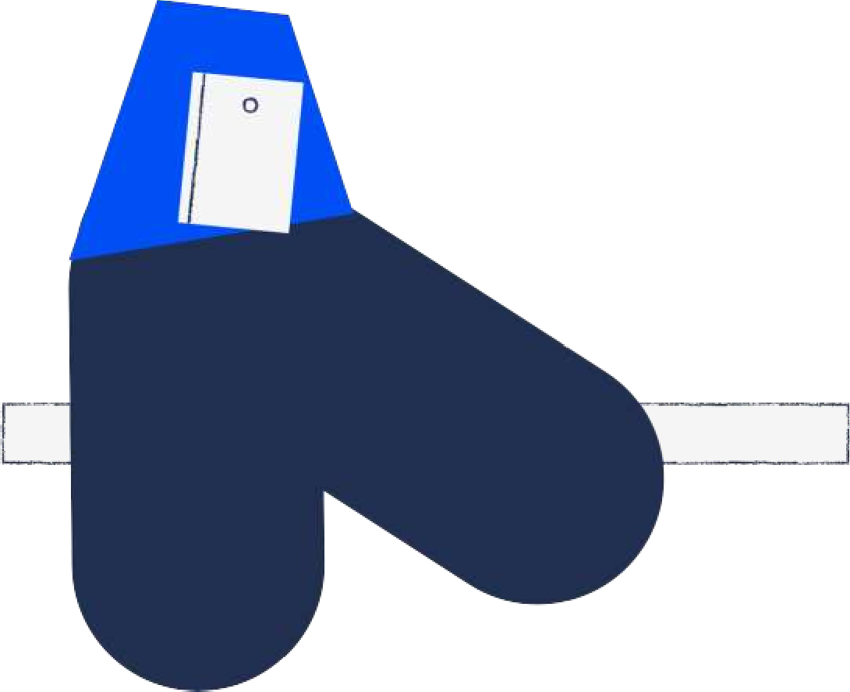
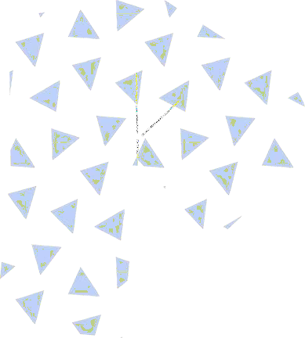





FUNTIONAL TEST CASES:
11.1

Slide 44
TEST SCENERIO | TEST CASE | EXECUTION STEPS | EXPECTED OUTCOMES | ACTUAL OUTCOME | STATUS | REMARKS | TEST ID
LOGIN | User login with valid credentials /authentic action | User Enter e-mail id User Enter Password click on the login button | User should be logged in and redirect to his dashboard page | User is logged in and redirected to the dashboard page | Pass | SUCESS | 1
CREATE USER ACCOUNT | User create account if he doesn't have an account | Click on create new account in login page Now Enter the detail and password Click on create | User New account will be created and will be redirected to login page | User New account has been created and redirected to login | PASS | SUCESS | 2
VEHICLE REGISTRATION | Vehicle Registration | User registration | User click on Registration User fill his correct details | user will be registered and the name of the user registered will be displayed on dashboard | PASS | SUCESS | 3
BOOKING APPOINTMENT | USER FILL THE DETAILS | Click on get appointment on dashboard table | The user get the appointment and redirected to destination | The user get the appointment and redirected to destination | PASS | SUCESS | 4
ADMIN | Track the vehicle and checks the parking location | Take the vehicle details from customer | vehicle details will be tracked and Can be blocked | vehicle details will be tracked and Can be blocked | PASS | SUCESS | 5

Slide 45
NON-FUNCTIONAL:
TEST ID | TEST SCENERIO | TEST CASE | EXECUTION STEPS | EXPECTED OUTCOME | ACTUAL OUTCOME | STATUS | REMARK
1 | RESPONSE TIME | Test page loading speed | Load one page to another | Load in less than 5 sec | Load around 4-3 sec | pass | success
2 | API | Data update to database | Run server | Server run smoothly | Server running smoothly | pass | success
3 | Data updating process | Data update to data base | Entry any details to post to database | Updated successfully | Data have got successfully updated | pass | success
11.2

Slide 46
TEST REPORTS:
Category | Progress Against Plan | Status
Functional Testing | Successful | Completed
Non-Functional Testing | Successful | Completed
------------------------- | ---------------------------- | -------------------
12

Slide 47










THANK YOU
we look forward to work with you

